Slide 1
2CS503 Design & Analysis of Algorithm Asymptotic Notation
Source: NPTEL, Coursera, Internet

Slide 2

Outline
Analysis of Algorithm
The efficient algorithm
Average, Best and Worst case analysis
Asymptotic Notations
Analyzing control statement
Loop invariant and the correctness of the algorithm
Sorting Algorithms and analysis: Bubble sort, Selection sort, Insertion sort, Shell sort and Heap sort
Sorting in linear time : Bucket sort, Radix sort and Counting sort
Amortized analysis
Looping

Slide 3


Introduction
What is Analysis of an Algorithm?
Analyzing an algorithm means calculating/predicting the resources that the algorithm requires.
Analysis provides theoretical estimation for the required resources of an algorithm to solve a specific computational problem.
Two most important resources are computing time (time complexity) and storage space (space complexity).
Why Analysis is required?
By analyzing some of the candidate algorithms for a problem, the most efficient one can be easily identified.

Slide 4
Efficiency of Algorithm
The efficiency of an algorithm is a measure of the amount of resources consumed in solving a problem of size 𝑛.
An algorithm must be analyzed to determine its resource usage.
Two major computational resources are execution time and memory space.
Memory Space requirement can not be compared directly, so the important resource is computational time required by an algorithm.
To measure the efficiency of an algorithm requires to measure its execution time using any of the following approaches:
Empirical Approach: To run it and measure how much processor time is needed.
Theoretical Approach: Mathematically computing how much time is needed as a function of input size.

Slide 5
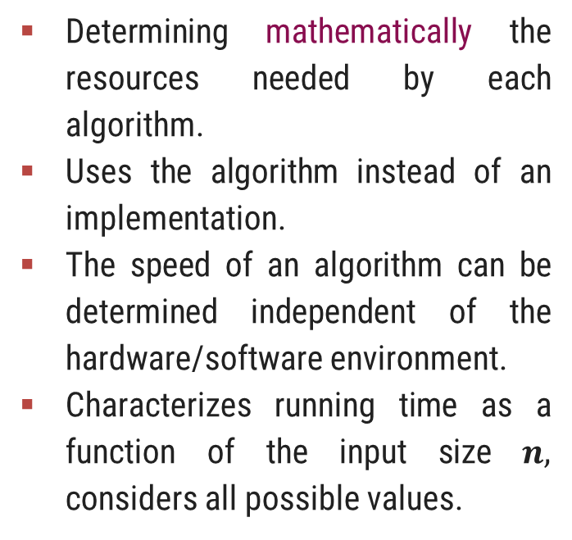
How Analysis is Done?
Empirical (posteriori) approach
Theoretical (priori) approach
Programming different competing techniques & running them on various inputs using computer.
Implementation of different techniques may be difficult.
The same hardware and software environments must be used for comparing two algorithms.
Results may not be indicative of the running time on other inputs not included in the experiment.
Determining mathematically the resources needed by each algorithm.
Uses the algorithm instead of an implementation.
The speed of an algorithm can be determined independent of the hardware/software environment.
Characterizes running time as a function of the input size $n,$ considers all possible values.

Slide 6
Time Complexity
Time complexity of an algorithm quantifies the amount of time taken by an algorithm to run as a function of the length of the input.
Running time of an algorithm depends upon,
Input Size
Nature of Input
Generally time grows with the size of input, for example, sorting 100 numbers will take less time than sorting of 10,000 numbers.
So, running time of an algorithm is usually measured as a function of input size.
Instead of measuring actual time required in executing each statement in the code, we consider how many times each statement is executed.
So, in theoretical computation of time complexity, running time is measured in terms of number of steps/primitive operations performed.

Slide 7
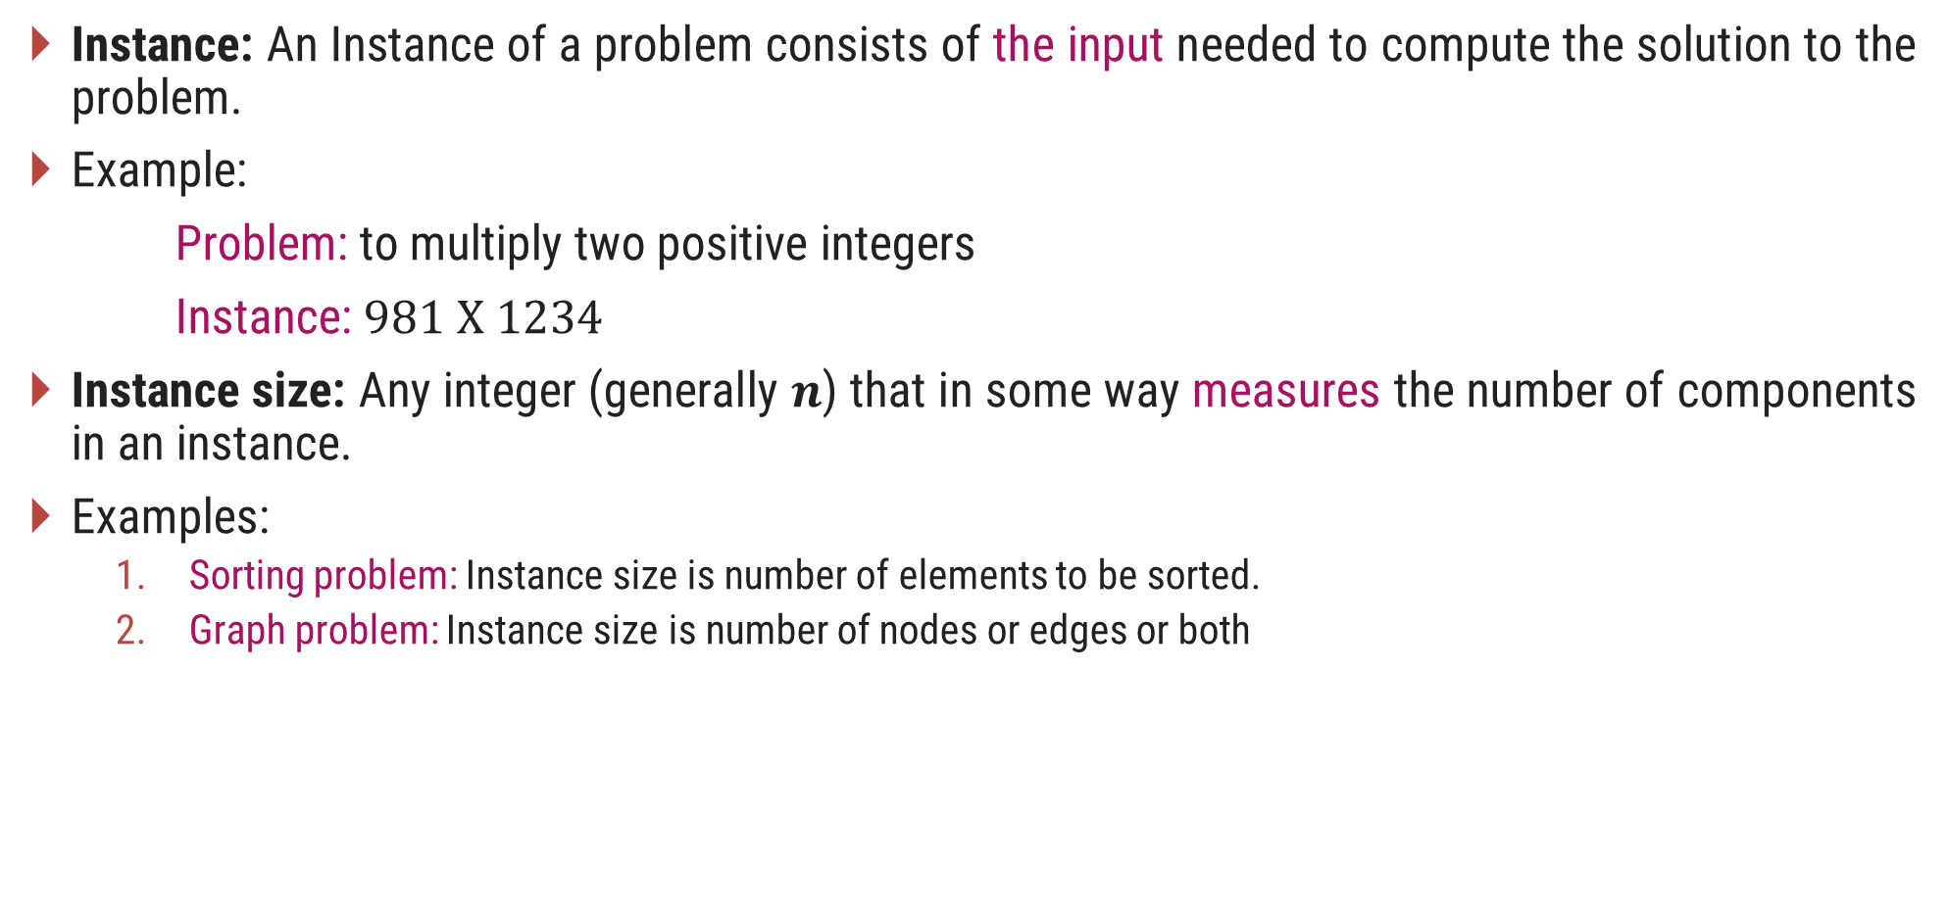
Problem & Instance
Instance: An Instance of a problem consists of the input needed to compute the solution to the problem.
Example:
Problem: to multiply two positive integers
Instance: $981 X 1234$
Instance size: Any integer (generally 𝒏) that in some way measures the number of components in an instance.
Examples:
Sorting problem: Instance size is number of elements to be sorted.
Graph problem: Instance size is number of nodes or edges or both

Slide 8

Linear Search
Suppose, you are given a jar containing some business cards.
You are asked to determine whether the name “Bill Gates" is in the jar.
To do this, you decide to simply go through all the cards one by one.
How long this takes?
Can be determined by how many cards are in the jar, i.e., Size of Input.
Linear search is a method for finding a particular value from the given list.
The algorithm checks each element, one at a time and in sequence, until the desired element is found.
Linear search is the simplest search algorithm.
It is a special case of brute-force search.

Slide 9

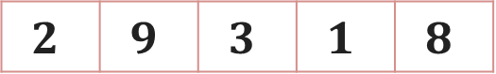
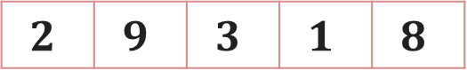
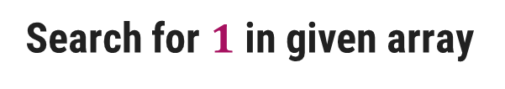
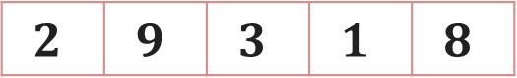
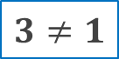
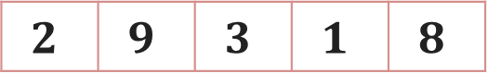
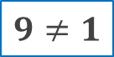
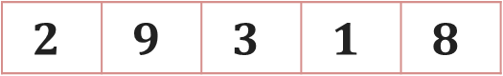
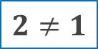
Linear Search – Example
Search for $1$ in given array
$$2$$ | $$9$$ | $$3$$ | $$1$$ | $$8$$
Comparing value of i^{th} index with the given element one by one, until we get the required element or end of the array
Step 1: i=1
Step 3: i=3
$$2$$ | $$9$$ | $$3$$ | $$1$$ | $$8$$
$$2$$ | $$9$$ | $$3$$ | $$1$$ | $$8$$
i
i
$$2≠1$$
$$3≠1$$
Step 2: i=2
Step 4: i=4
$$2$$ | $$9$$ | $$3$$ | $$1$$ | $$8$$
$$2$$ | $$9$$ | $$3$$ | $$1$$ | $$8$$
$$1$$
i
i
$$9≠1$$
Element found at i^{th} index, i=4

Slide 10
Linear Search - Algorithm
# Input : Array A, element x
# Output : First index of element x in A or -1 if not found
Algorithm: Linear_Search
for i = 1 to last index of A
if A[i] equals element x
return i
return -1

Slide 11
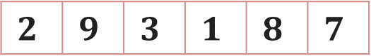


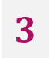
Linear Search - Analysis
The required element in the given array can be found at,
E.g. 2: It is at the first position
Best Case: minimum comparison is required
E.g. 3 or 1: Anywhere after the first position
Average Case: average number of comparison is required
E.g. 7: Last position or element does not found at all
Worst Case: maximum comparison is required
Worst Case
Search for $2$
$$3$$
$$7$$
$$2$$ | $$9$$ | $$3$$ | $$1$$ | $$8$$ | $$7$$
Best Case
Average Case

Slide 12
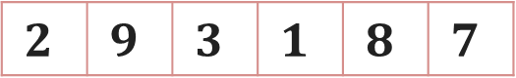


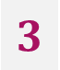
Linear Search - Analysis
The required element in the given array can be found at,
Case 1: element 2 which is at the first position so minimum comparison is required
Case 2: element 3 anywhere after the first position so, an average number of comparison is required
Case 3: element 7 at last position or element does not found at all, maximum comparison is required
Best Case
Average Case
Worst Case
Worst Case
Search for $2$
$$3$$
$$7$$
$$2$$ | $$9$$ | $$3$$ | $$1$$ | $$8$$ | $$7$$
Best Case
Average Case

Slide 13
Analysis of Algorithm
Best Case | Average Case | Worst Case
Resource usage is minimum | Resource usage is average | Resource usage is maximum
Algorithm’s behavior under optimal condition | Algorithm’s behavior under random condition | Algorithm’s behavior under the worst condition
Minimum number of steps or operations | Average number of steps or operations | Maximum number of steps or operations
Lower bound on running time | Average bound on running time | Upper bound on running time
Generally do not occur in real | Average and worst-case performances are the most used in algorithm analysis.

Slide 14
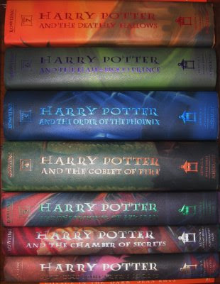
Book Finder Example
Suppose, you are writing a program to find a book from the shelf.
For any required book, it will start checking books one by one from the bottom.
If you wanted Harry Potter 3, it would only take 3 actions (or tries) because it’s the third book in the sequence.
If Harry Potter 7 — it’s the last book so it would have to check all 7 books.
What if there are total 10 books? How about 10,00,000 books? It would take 1 million tries.

Slide 15
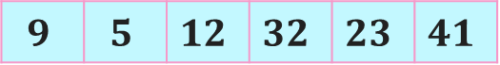
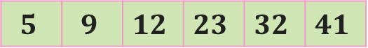
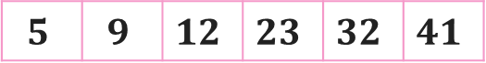
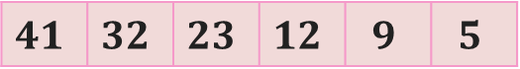
Number Sorting - Example
Suppose you are sorting numbers in Ascending / Increasing order.
The initial arrangement of given numbers can be in any of the following three orders.
Numbers are already in required order, i.e., Ascending order
No change is required – Best Case
Numbers are randomly arranged initially.
Some numbers will change their position – Average Case
Numbers are initially arranged in Descending or Decreasing order.
All numbers will change their position – Worst Case
$$5$$ | $$9$$ | $$12$$ | $$23$$ | $$32$$ | $$41$$
$$9$$ | $$5$$ | $$12$$ | $$32$$ | $$23$$ | $$41$$
$$5$$ | $$9$$ | $$12$$ | $$23$$ | $$32$$ | $$41$$
$$41$$ | $$32$$ | $$23$$ | $$12$$ | $$9$$ | $$5$$

Slide 16
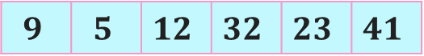
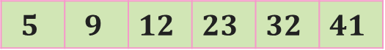
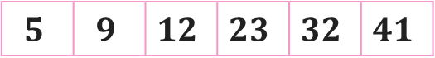
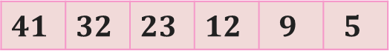
Number Sorting - Example
Suppose you are sorting numbers in Ascending / Increasing order.
The initial arrangement of given numbers can be in any of the following three orders.
Case 1: Numbers are already in required order, i.e., Ascending order
No change is required
Case 2: Numbers are randomly arranged initially. Some numbers will change their position
Case 3: Numbers are initially arranged in Descending order so, all numbers will change their position
Best Case
Average Case
Worst Case
$$5$$ | $$9$$ | $$12$$ | $$23$$ | $$32$$ | $$41$$
$$9$$ | $$5$$ | $$12$$ | $$32$$ | $$23$$ | $$41$$
$$5$$ | $$9$$ | $$12$$ | $$23$$ | $$32$$ | $$41$$
$$41$$ | $$32$$ | $$23$$ | $$12$$ | $$9$$ | $$5$$

Slide 17
Best, Average, & Worst Case
Problem | Best Case | Average Case | Worst Case
Linear Search | Element at the first position | Element in any of the middle positions | Element at last position or not present
Book Finder | The first book | Any book in-between | The last book
Sorting | Already sorted | Randomly arranged | Sorted in reverse order

Slide 18
What is a Good Algorithm?
Efficient
Running time
Space used
Efficiency as a function of input size
The number of bits in an input number
Number of data elements(Numbers and Points)

Slide 19
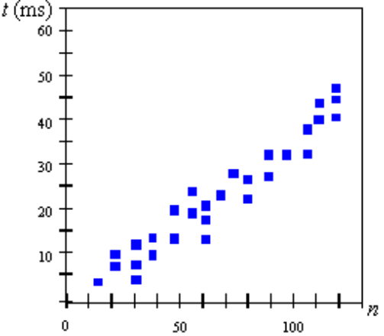
Measuring the Running Time
How should we measure the running time of an algorithm?
Experimental Study
Write a program that implements the algorithm
Run the program with data sets of varying size and composition.
Use a method like System.currentTimeMillis() to get an accurate measure of the actual running time

Slide 20
Limitations of Experimental Studies
It is necessary to implement and test the algorithm in order to determine its running time.
Experiments can be done only on a limited set of inputs, and may not be indicative of the running time on other inputs not included in the experiment.
In order to compare two algorithms, the same hardware and software environments should be used.

Slide 21
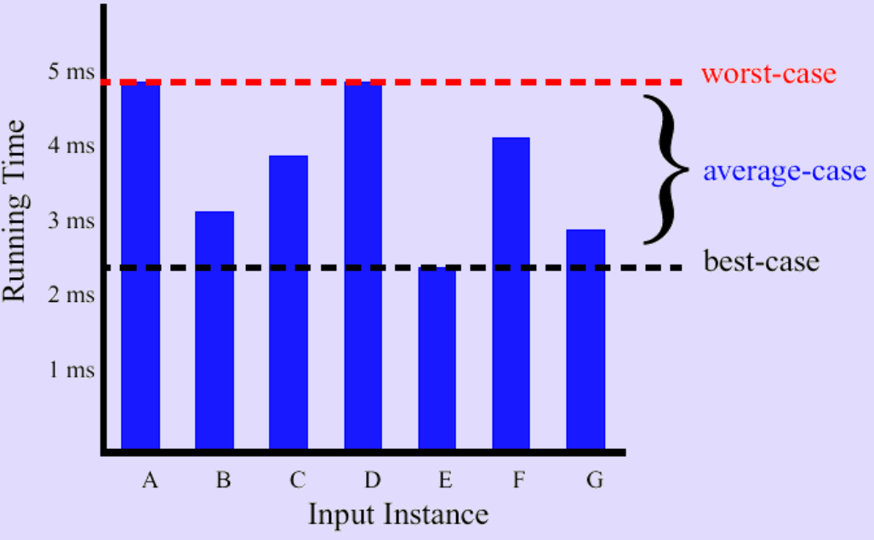
Best/Worst/Average Case
For a specific size of input n, investigate running times for different input instances:

Slide 22
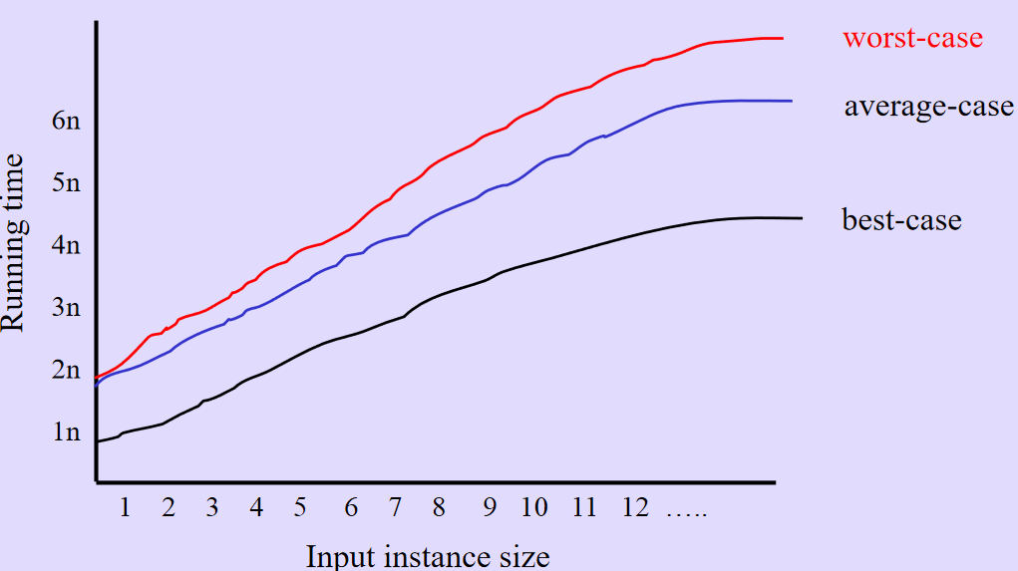
Best/Worst/Average Case
For inputs of all sizes:

Slide 23
Asymptotic Notations

Slide 24
Given two algorithms A1 and A2 for a problem, how do we decide
which one runs faster?
What we need is a platform independent way of comparing algorithms.
Solution: Count the worst-case number of basic operations b(n) for inputs of size n and then analyse how this function b(n) behaves as n grows. This is known as worst-case analysis.
Observations regarding worst-case analysis:
Usually, the running time grows with the input size n.
Consider two algorithm A1 and A2 for the same problem. A1 has a worst-case running time (100n + 1) and A2 has a worst-case running time (2n² + 3n + 1). Which one is better?
A2 runs faster for small inputs (e.g., n = 1, 2)
A1 runs faster for all large inputs (for all n ≥ 49)
We would like to make a statement independent of the input size.
Solution: Asymptotic analysis
We consider the running time for large inputs.
A1 is considered better than A2 since A1 will beat A2 eventually

Slide 25
continue..
Solution: Do an asymptotic worst-case analysis.
Observations regarding asymptotic worst-case analysis:
It is difficult to count the number of operations at an extremely fine level and keep track of these constants.
Asymptotic analysis means that we are interested only in the rate of growth of the running time function w.r.t. the input size. For example, note that the rates of growth of functions (n² + 5n + 1) and (n² + 2n + 5) is determined by the n² (quadratic) term. The lower order terms are insignificant. So, we may as well drop them.
The nature of growth rate of functions 2n² and 5n² are the same. Both are quadratic functions. It makes sense to drop these constants too when one is interested in the nature of the growth functions.
These constants typically depends upon system you are using, such as hardware, compiler etc.
We need a notation to capture the above ideas.

Slide 26
Introduction
The theoretical (priori) approach of analyzing an algorithm to measure the efficiency does not depend on the implementation of the algorithm.
In this approach, the running time of an algorithm is describes as Asymptotic Notations.
Computing the running time of algorithm’s operations in mathematical units of computation and defining the mathematical formula of its run-time performance is referred to as Asymptotic Analysis.
An algorithm may not have the same performance for different types of inputs. With the increase in the input size, the performance will change.
Asymptotic analysis accomplishes the study of change in performance of the algorithm with the change in the order of the input size.
Using Asymptotic analysis, we can very well define the best case, average case, and worst case scenario of an algorithm.

Slide 27
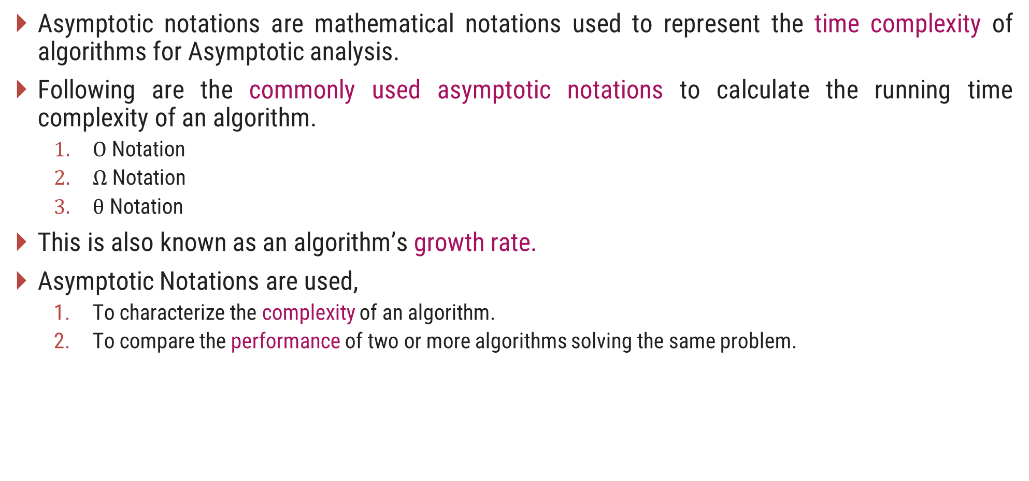
Asymptotic Notations
Asymptotic notations are mathematical notations used to represent the time complexity of algorithms for Asymptotic analysis.
Following are the commonly used asymptotic notations to calculate the running time complexity of an algorithm.
$Ο$ Notation
$Ω$ Notation
$θ$ Notation
This is also known as an algorithm’s growth rate.
Asymptotic Notations are used,
To characterize the complexity of an algorithm.
To compare the performance of two or more algorithms solving the same problem.

Slide 28
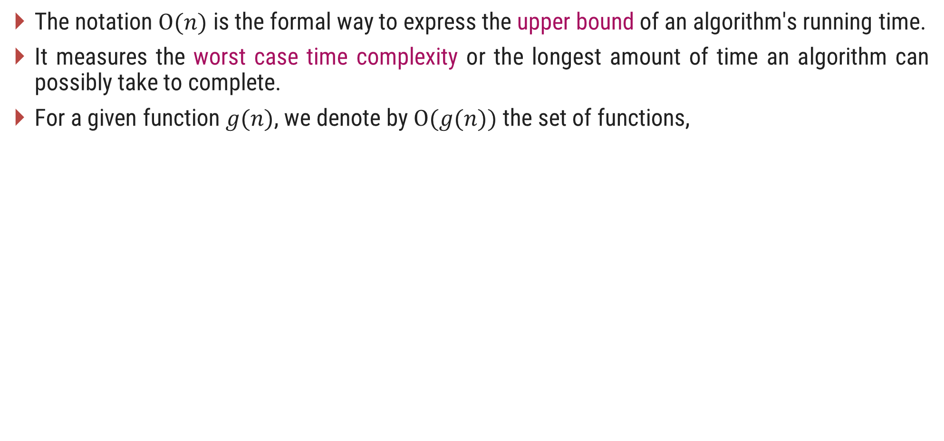
$O$-Notation (Big $O$ notation) (Upper Bound)
The notation $Ο(n)$ is the formal way to express the upper bound of an algorithm's running time.
It measures the worst case time complexity or the longest amount of time an algorithm can possibly take to complete.
For a given function $g(n)$, we denote by $Ο(g(n))$the set of functions,
$Ο(g(n))$= {$f(n)$ : there exist positive constants $c$ and $n0$ such that $0≤f(n)≤cg(n)$for all $n0≤n$}

Slide 29
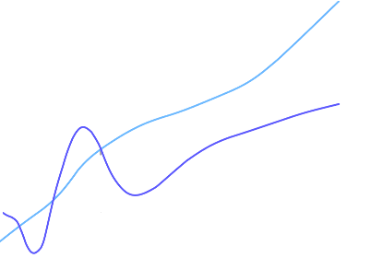
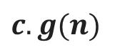
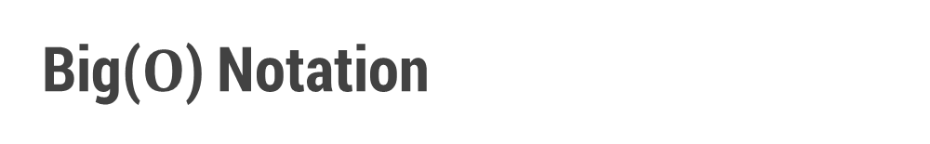
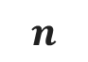
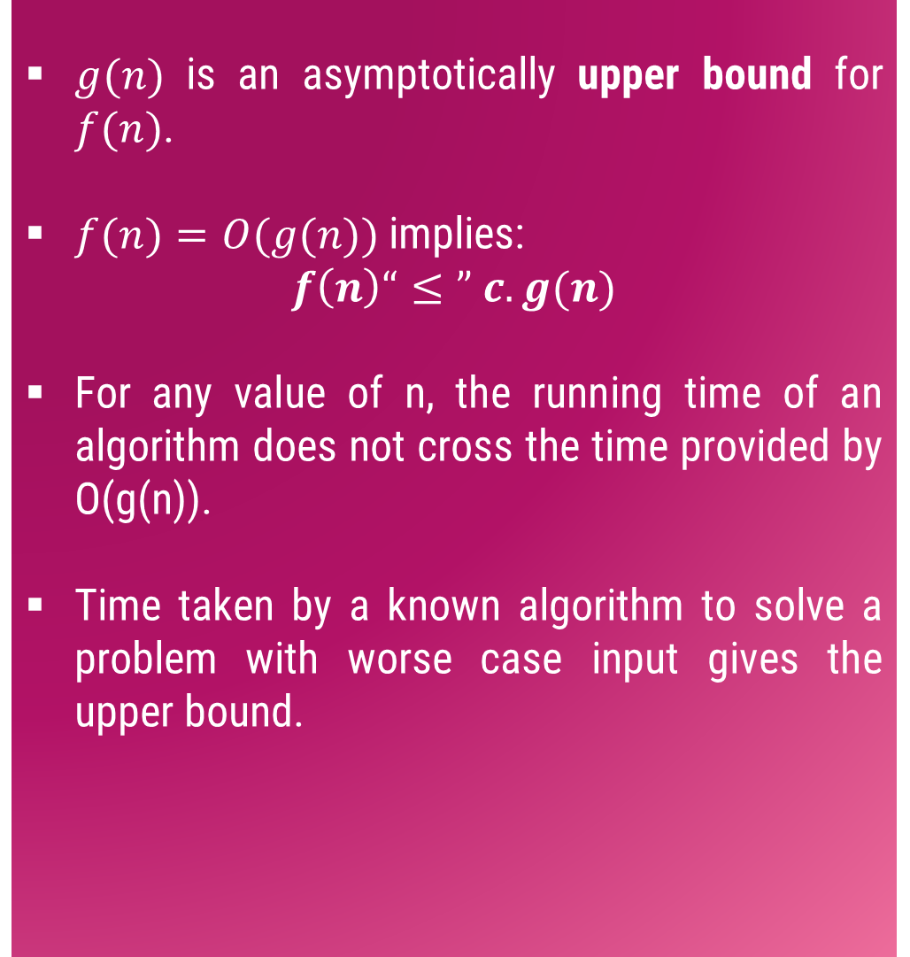
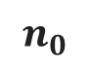
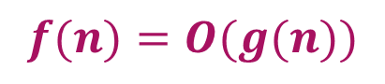
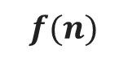
Big($O$) Notation
$g(n)$ is an asymptotically upper bound for $f(n)$.
$f(n)=O(g(n))$implies:
$$f\left(n\right)“≤” c.g(n)$$
For any value of n, the running time of an algorithm does not cross the time provided by O(g(n)).
Time taken by a known algorithm to solve a problem with worse case input gives the upper bound.
$$c.g(n)$$
$$f(n)$$
$$n$$
$$n_{0}$$
$$f(n)=O(g(n))$$

Slide 30
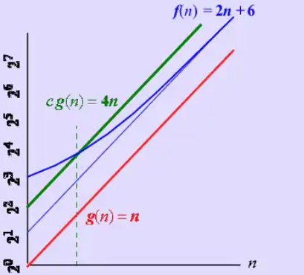
Example
For a function f(n) and g(n) there are positive constants c and n₀ such that :
f(n) ≤ c.g(n) for n ≥ n₀
Conclusion: 2n+6 is O(n)

Slide 31
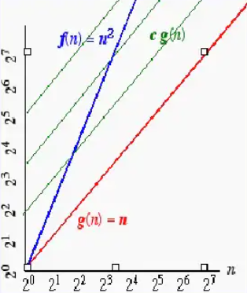
Example
On the other hand n² is not O(n) because
there is no c and n₀ such that:
n² ≤ cn for n ≥ n₀
The graph shows that no matter how large
a c is chosen there is an n big enough
that n² > cn.

Slide 32
Simple rule
Drop lower order term and constant factor
50 n log n is O(n log n)
7n -3 is O(n)
8n² log n + 5n² + n is O(n² log n )
Use O-notations to express number of primitive operations executed as function of input size.
Comparing asymptotic running time:
an algorithm that runs O(n) times is better than one that runs in O(n²) times
similarly, O(logn) is better than O(n)
Hierarchy of function: log n < n < n² < n³ < 2^{n}

Slide 33
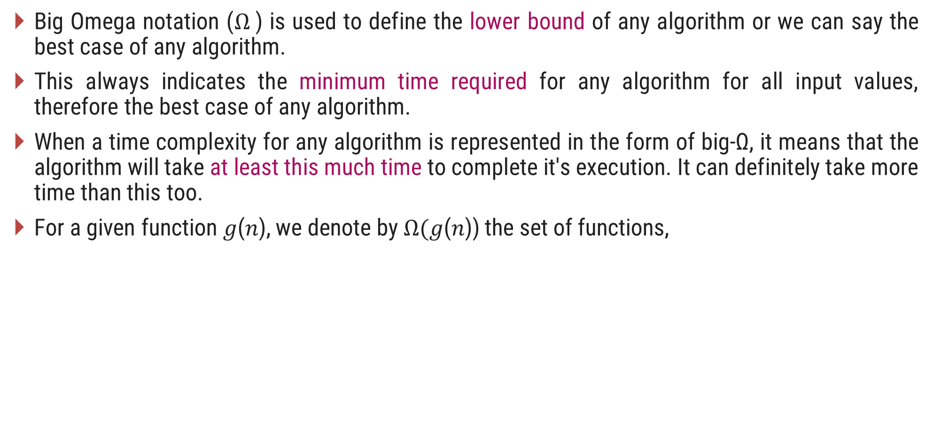
$Ω$-Notation (Omega notation) (Lower Bound)
Big Omega notation ($Ω$) is used to define the lower bound of any algorithm or we can say the best case of any algorithm.
This always indicates the minimum time required for any algorithm for all input values, therefore the best case of any algorithm.
When a time complexity for any algorithm is represented in the form of big-Ω, it means that the algorithm will take at least this much time to complete it's execution. It can definitely take more time than this too.
For a given function 𝑔(𝑛), we denote by $Ω($𝑔(𝑛)) the set of functions,
$Ω(g(n))=\{f(n):$there exist positive constants $c$ and $n_{0}$ such that $0≤cg\left(n\right)≤f\left(n\right)$for all $n_{0}≤n\}$

Slide 34
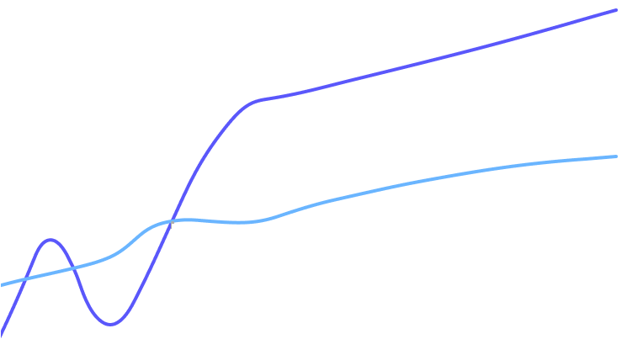
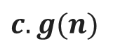
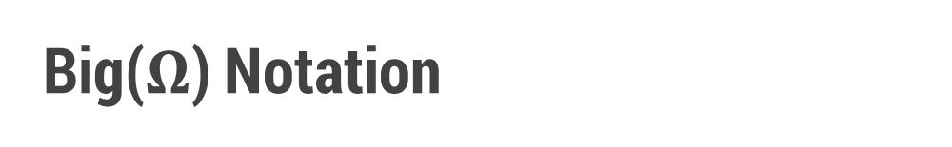
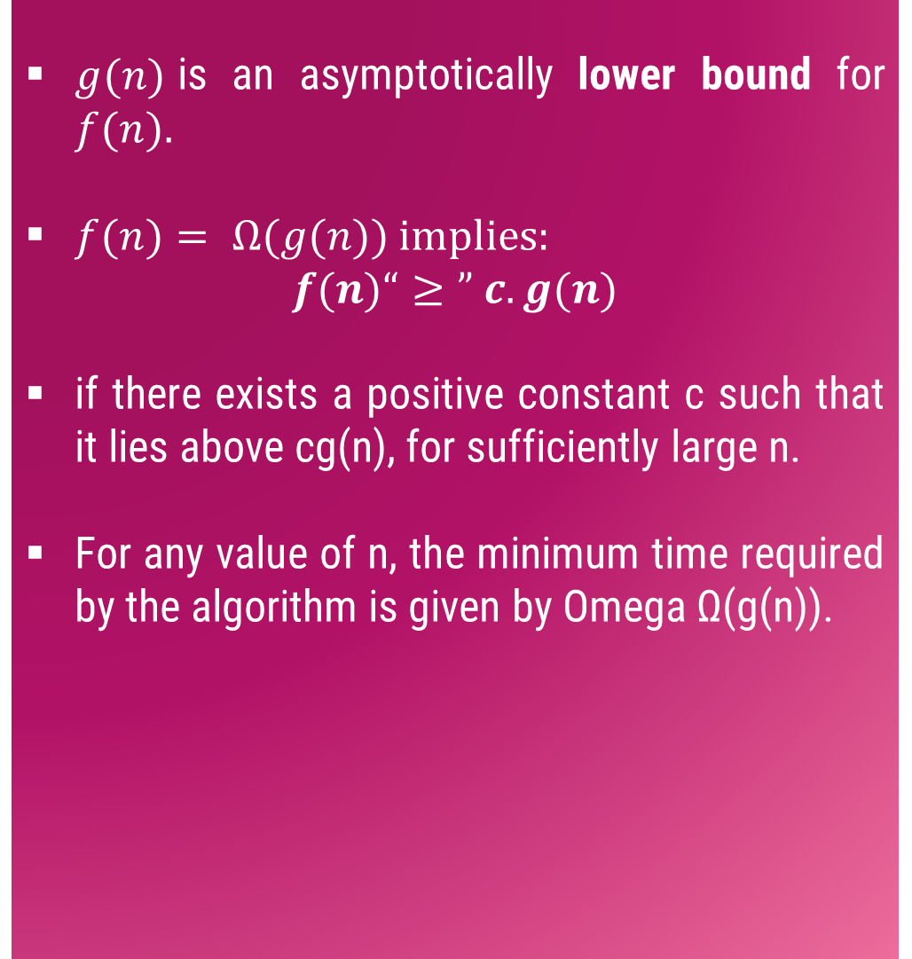
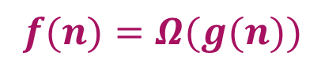
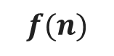
Big($Ω$) Notation
$g(n)$is an asymptotically lower bound for $f(n).$
$f(n)= Ω(g(n))$implies:
$$f(n)“≥” c.g(n)$$
if there exists a positive constant c such that it lies above cg(n), for sufficiently large n.
For any value of n, the minimum time required by the algorithm is given by Omega Ω(g(n)).
$$f(n)$$
$$c.g(n)$$
$$n$$
$$n_{0}$$
$$f(n)=Ω(g(n))$$

Slide 35
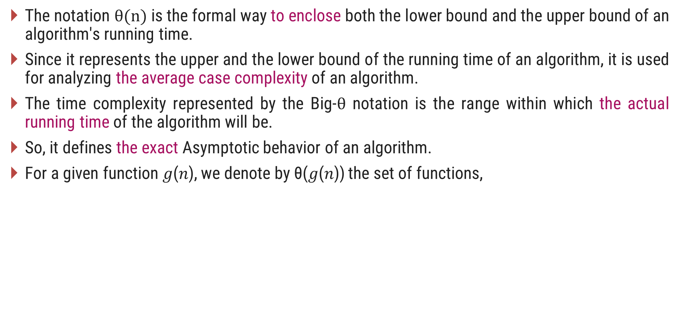
$θ$-Notation (Theta notation) (Same order)
The notation $θ(n)$is the formal way to enclose both the lower bound and the upper bound of an algorithm's running time.
Since it represents the upper and the lower bound of the running time of an algorithm, it is used for analyzing the average case complexity of an algorithm.
The time complexity represented by the Big-$θ$ notation is the range within which the actual running time of the algorithm will be.
So, it defines the exact Asymptotic behavior of an algorithm.
For a given function 𝑔(𝑛), we denote by θ(𝑔(𝑛)) the set of functions,
$θ(g(n))\text{ = \{}f(n)\text{ : }$there exist positive constants $c_{1}\text{, }c_{2} \text{and} n0 \text{such} \text{that} 0≤c_{1}g\left(n\right)≤f\left(n\right)≤c_{2}g\left(n\right) \text{for} \text{all} n0≤n\text{\}}$

Slide 36
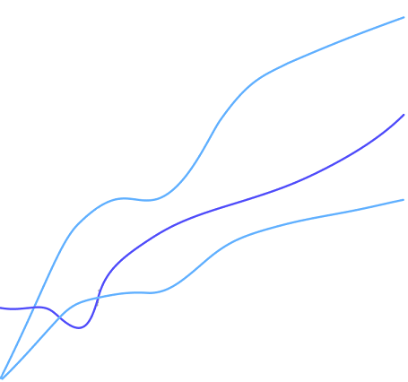
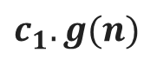
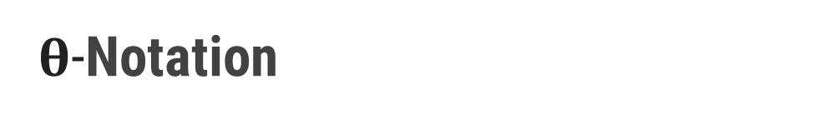






$θ$-Notation
$θ(g(n))$is a set, we can write $f(n) ε θ(g(n))$to indicate that $f(n)$is a member of $θ(g(n)).$
$g(n)$is an asymptotically tight bound for $f(n).$
$f(n)=θ(g(n))$implies:
$$f(n)“=” c.g(n)$$
If a function f(n) lies anywhere in between c1g(n) and c2g(n) for all n ≥ n0, then f(n) is said to be asymptotically tight bound.
f(n) is Θ(g(n)) if and only if f(n) is Ο(g(n)) and f(n) is Ω(g(n))
$$c_{2}.g(n)$$
$$f(n)$$
$$c_{1}.g(n)$$
$$n$$
$$n_{0}$$
$$f(n)=θ(g(n))$$

Slide 37






Asymptotic Notations
O-Notation (Big O notation) (Upper Bound)
Ω-Notation (Omega notation) (Lower Bound)
θ-Notation (Theta notation) (Same order)
$Ο(g(n))$= {$f(n)$ : there exist positive constants $c$ and${ n}_{0}$ such that$0≤f(n)≤g(n)$for all$n0≤n$}
$$f(n)=O(g(n))$$
$\text{Ω}(g(n))$= {$f(n)$ : there exist positive constants $c$ and $n_{0}$ such that $0≤cg\left(n\right)≤f\left(n\right)$ for all $n_{0}≤n$}
$$f\left(n\right)=\text{Ω}(g(n))$$
$θ(g(n))$ = {$f(n)$ : there exist positive constants $c_{1}$, $c_{2}$ and${ n}_{0}$such that $0≤c_{1}g\left(n\right)≤f\left(n\right)≤c_{2}g\left(n\right)$ for all $n_{0}≤n$}
$$f(n)=θ(g(n))$$

Slide 38






Asymptotic Notations – Examples
Example 1:
$f(n)=n^{2}$ and $g\left(n\right)=n$
Example 2:
$f\left(n\right)=n$ and $g\left(n\right)=n^{2}$
Algo. 1 running time
Algo. 2 running time
Algo. 1 running time
Algo. 2 running time
$$f\left(n\right)≥g\left(n\right)⟹f\left(n\right)=\text{Ω}(g(n))$$
$$f\left(n\right)≤g\left(n\right)⟹f\left(n\right)=\text{O}(g(n))$$
$$n$$ | $$f(n)=n2$$ | $$g(n)=n$$
$$n$$ | $$f(n)=n$$ | $$g(n)=n2$$
1
1
1
1
1
1
2
4
2
2
2
4
3
9
3
3
3
9
4
16
4
4
4
16
5
25
5
5
5
25

Slide 39




Asymptotic Notations – Examples
Example 3: $f\left(n\right)=n^{2}$ and $g\left(n\right)= 2^{n}$
$$f\left(n\right)≤g\left(n\right)⟹f\left(n\right)=\text{O}(g(n))$$
$$n$$ | $$f(n)=n2$$ | $$g(n)=2n$$
1 |  |  | $$f(n) < g(n)$$
2 |  |  | $$f(n) = g(n)$$
3 |  |  | $$f(n) > g(n)$$
4 |  |  | $$f(n) = g(n)$$
5 |  |  | $$f(n) < g(n)$$
6 |  |  | $$f(n) < g(n)$$
7 |  |  | $$f(n) < g(n)$$
1
2
4
4
9
8
16
16
Here for $n≥4$, $f\left(n\right)≤g\left(n\right)$
$$so, n0=4$$
25
32
36
64
49
128

Slide 40



Asymptotic Notations – Examples
Example 4:
$f(n)=30n+8$is in the order of $n$, or $O(n)$
$g(n)=n^{2}+1$is order $n^{2}$, or $O(n^{2})$
In general, any $O(n^{2})$ function is faster-growing than any $O(n)$ function.
$$f(n) = O(g(n))$$
g (n)=n²+1
f(n)=30n+8
Value of function →
Base value $n_{0}$
Increasing n →

Slide 41

Common Orders of Magnitude
$$n$$ | $$\log{n}$$ | $$nlog n$$ | $$n2$$ | $$n3$$ | $$2n$$ | $$n!$$
4 | 2 | 8 | 16 | 64 | 16 | 24
16 | 4 | 64 | 256 | 4096 | 65536 | 2.09 x 10¹³
64 | 6 | 384 | 4096 | 262144 | 1.84 × 10¹⁹ | 1.26 x 10²⁹
256 | 8 | 2048 | 65536 | 16777216 | 1.15 × 10⁷⁷ | $$∞$$
1024 | 10 | 10240 | 1048576 | 1.07 × 10⁹ | 1.79 × 10³⁰⁸ | $$∞$$
4096 | 12 | 49152 | 16777216 | 6.87 × 10¹⁰ | 10¹²³³ | $$∞$$

Slide 42



Growth of Function
Arrange the given notations in the increasing order of their values.
For each of the following pairs of functions, either $f(n)$ is $O(g(n))$, $f(n)$ is $Ω(g(n))$, or $f(n) =θ(g(n))$. Determine which relationship is correct.
1. | $$n$$ | $$nlogn$$ | $$2n$$ | $$logn$$ | $$\sqrt{n}$$ | $$en$$ | $$n2+logn$$ | $$n2$$ | $$loglogn$$ | $$n3$$ | $$(logn)2$$ | $$n!$$
2. | $$n8$$ | $$(n^{2}−n+1)4{}^{}$$ | $$nn$$ | $$n^{(1+e)}$$ | $${(1+e) }^{n}$$ | $${n^{2}}/{logn}$$ | $$nlogn$$
$$f(n)=n; g(n)=n^{2}$$ | $$f(n)=10; g(n)=log⁡10$$
$$f(n)=log⁡log⁡n; g(n)=log⁡n$$ | $$f(n)=2^{n}; g(n)=10n^{2}$$
$$f(n)=n; g(n)=\log^{2} n$$ | $$f\left(n\right)=2n; g(n)=3n$$
$$f(n)=n log⁡n + n; g(n)=log⁡n$$ | $$f(n)=n; g(n)=log⁡n^{2}$$

Slide 43

Asymptotic Notations in Equations
Consider an example of buying elephants and goldfish:
Cost = cost_of_elephants + cost_of_goldfish
Cost ≈ cost_of_elephants (approximation)
Maximum Rule: Let, $f, g: N→ R^{+}$ the max rule says that:
$n^{4} + 100n^{2} + 10n + 50 is O(n^{4})$
$10n^{3} + 2n^{2} is O(n^{3})$
$n^{3}$ - $n^{2}$ is $O(n^{3})$
The low order terms in a function are relatively insignificant for large 𝒏
$n^{4} + 100n^{2} + 10n + 50≈ n^{4}$
Negligible
𝑂( 𝑓(𝑛)+𝑔(𝑛))=𝑂(max⁡(𝑓(𝑛),𝑔(𝑛)))

Slide 44

Exercises
Express the function $n3/1000 − 100n2 − 100n + 3$in terms of θ notation.
Express $20n3 + 10n log⁡n + 5$in terms of O notation.
Express $5n log⁡n + 2n$in terms of O notation.
Prove or disprove (i) Is 2^{n+1} = O(2^{n}) (ii) Is 2^{2n} = O(2^{n})
Check the correctness for the following equality, $5n^{3}+2n=O(n^{3})$
Find θ notation for the following function
$F(n) = 3 ∗ 2n + 4n2 + 5n + 2$
Find O notation for the following function
$F(n) = 2n + 6n2 + 3n$
$F(n) = 4n3 + 2n + 3$
Find Ω notation for the following function
$F(n) = 4∗ 2n + 3n$
$F(n) = 5n3 + n2 + 3n + 2$

Slide 45
Methods of proving Asymptotic Notations
1) Proof by definition : In this method, we apply the formal definition of the asymptotic notation, and find out the values of constants c > 0 and n₀ > 0, such that the required notation is proved.
2) Proof by Limit Rules : In this method, we apply certain rules of limit, and then prove the required notation.

Slide 46
Proof by definition
Prove the following statements :
n² + n = O(n²)
According to the formal definition, let f(n) = n² + n and g(n) = n²
Find the values of constants c > 0 and n₀ > 0, such that 0 ≤ f(n) ≤ c g(n), for all n ≥ n₀ (condition for Big-O notation)2
n³ + 4n² = Ω(n²)
According to the formal definition, let f(n) = n³ + 4n² and g(n) = n²
Find the values of constants c > 0 and n0 > 0, such that 0 ≤ c g(n) ≤ f(n), for all n ≥ n₀ (condition for Big-Ω notation)
n² + n = Θ(n²)
According to the formal definition, let f(n) = n² + n and g(n) = n²
Find the values of constants c1 > 0, c2 > 0, and n0 > 0, such that 0 ≤ c1 g(n) ≤ f(n) ≤ c2 g(n), for all n ≥ n₀ (condition for Θ notation)
≈ O(n³)
≈ Ω(n)

Slide 47

Proof by Limit Rules
If f(n) and g(n) are asymptotically increasing functions, then the following rules hold true:
Prove that : √n grows asymptotically faster than log n.
Proof: Let us consider f(n) = √n and g(n) = log n
We compute and then based on the result, the specific
“Limit Rule” proves the desired result.

Slide 48
Little-Oh and Little-Omega
f(n)=o(g(n)) => For every c, there should exist n₀ , s.t. f(n) ≤ c g(n) for n ≥ n₀
f(n)=ω(g(n)) => For every c, there should exist n₀ , s.t. f(n) ≥ c g(n) for n ≥ n₀
Analogy with real numbers
f(n) = O(g(n)) ≅ f ≤ g
f(n) = Ω(g(n)) ≅ f ≥ g
f(n) = Θ(g(n)) ≅ f = g
f(n) = o(g(n)) ≅ f < g
f(n) = ω(g(n)) ≅ f > g

Slide 49




Math You Need to Review
Properties of logarithms:
Properties of exponentials:
Geometric progression:
Arithmetic progression:

Slide 50
Analyzing Control Statements

Slide 51
For Loop
# Input : int A[n], array of n integers
# Output : Sum of all numbers in array A
Algorithm: int Sum(int A[], int n)
{
int s=0;
for (int i=0; i<n; i++)
s = s + A[i];
return s;
}
n+1
1
n
Total time taken = n+1+n+2 = 2n+3
Time Complexity f(n) = 2n+3

Slide 52









Running Time of Algorithm
The time complexity of the algorithm is : $f\left(n\right)= 2 ∙n +3$
Estimated running time for different values of 𝑛 :
As 𝑛 grows, the number of steps grow in linear proportion to 𝑛 for the given algorithm Sum.
The dominating term in the function of time complexity is $n$: As $n$ gets large, the $+3$ becomes insignificant.
The time is linear in proportion to $n$.
$$n=10$$
$23$ steps
$$n=100$$
$203$ steps
$$n=1000$$
$2,003$ steps
$$n=10000$$
$20,003$ steps

Slide 53











Analyzing Control Statements
Example 1:
Example 3:
$$sum=a+b;$$
Statement is executed once only
So, The execution time $T(n)$ is some constant $c≈O(1)$
$$c_{1} \left(n+1\right)$$
$$c$$
$$for i=1 to n do$$
$$for j = 1 to n do$$
$$sum=a+b;$$
Analysis
$$T\left(n\right)=c_{1}\left(n+1\right)+c_{2}n\left(n+1\right)+c_{3}n\left(n\right)$$
$$T(n) =c_{1}n+c_{1}+c_{2}n2+c_{2}n+c_{3}n2$$
$$T(n) = n2(c_{2}+c_{3}) + n(c_{1}+c_{2}) +c_{1}$$
$$T(n) = an2 + bn + c$$
$$T(n)=O\left(n^{2}\right)$$
$$c_{2} n \left(n+1\right)$$
$$c_{3}∗n∗n$$
Example 2:
$$c_{1}$$
$$for i=1 to n do$$
$$sum=a+b;$$
Total time is denoted as,
$$T\left(n\right)=c_{1}n+c_{1}+c_{2}n$$
$$T(n)=n(c_{1}+c_{2})+c_{1}≈O(n)$$
$$∗\left(n+1\right)$$
$$c_{2}$$
$$∗\left(n\right)$$

Slide 54









Analyzing Control Statements
Example 4:
Example 6:
$$l = 0$$
$$for i = 1 to n do$$
$$for j = 1 to i do$$
$$for k = j to n do$$
$$l = l + 1$$
$$for j = 1 to n do$$
$$for k = 1 to j do$$
$$sum = sum + j∗k$$
$$for l =1 to n do$$
$$sum=sum− l + 1$$
printf(“sum is now %d”,$sum$)
$$θ\left(n^{2}\right)$$
$$θ\left(n\right)$$
$$t\left(n\right)=θ\left(n^{3}\right)$$
$$θ\left(1\right)$$
Example 5:
$$l = 0$$
$$for i = 1 to n do$$
$$for j = 1 to n^{2} do$$
$$for k =1 to n^{3} do$$
$$l = l + 1$$
$$t\left(n\right)=θ\left(n^{2}\right)+θ\left(n\right)+θ\left(1\right)$$
$$t\left(n\right)=θ\left(n^{2}\right)$$
$$t\left(n\right)=θ\left(n^{6}\right)$$

Slide 55
Sorting Algorithms
Bubble Sort, Selection Sort, Insertion Sort

Slide 56
Introduction
Sorting is any process of arranging items systematically or arranging items in a sequence ordered by some criterion.
Applications of Sorting
Phone Bill: the calls made are date wise sorted.
Bank statement or Credit card Bill: transactions made are date wise sorted.
Filling forms online: “select country” drop down box will have the name of countries sorted in Alphabetical order.
Online shopping: the items can be sorted price wise, date wise or relevance wise.
Files or folders on your desktop are sorted date wise.

Slide 57

Bubble Sort – Example
Sort the following array in Ascending order
45 | 34 | 56 | 23 | 12
Pass 1 :
45
34
swap
34
34
34
34
45
45
45
45
56
56
56
23
swap
23
23
23
23
56
56
12
swap
12
12
12
12
56
$$if(A[j] > A[j+1])$$
$$swap(A[j],A[j+1])$$

Slide 58
Bubble Sort – Example
Pass 2 :
Pass 3 :
Pass 4 :
34
34
34
34
23
23
23
swap
12
swap
34
45
45
12
23
23
23
34
12
swap
swap
23
12
23
23
34
45
45
12
swap
12
34
12
12
12
45
45
45
45
56
56
56
56
56
56
$$if(A[j] > A[j+1])$$
$$swap(A[j],A[j+1])$$

Slide 59


Bubble Sort - Algorithm
# Input: Array A
# Output: Sorted array A
Algorithm: Bubble_Sort(A)
for i ← 1 to n-1 do
for j ← 1 to n-i do
if A[j] > A[j+1] then
swap(A[j], A[j+1])
$$θ\left(n\right)$$
temp ← A[j]
A[j] ← A[j+1]
A[j+1] ← temp
$$θ\left(n^{2}\right)$$

Slide 60

Bubble Sort
It is a simple sorting algorithm that works by comparing each pair of adjacent items and swapping them if they are in the wrong order.
The pass through the list is repeated until no swaps are needed, which indicates that the list is sorted.
As it only uses comparisons to operate on elements, it is a comparison sort.
Although the algorithm is simple, it is too slow for practical use.
The time complexity of bubble sort is $θ\left(n^{2}\right)$

Slide 61

Bubble Sort Algorithm – Best Case Analysis
# Input: Array A
# Output: Sorted array A
Algorithm: Bubble_Sort(A)
int flag=1;
for i ← 1 to n-1 do
for j ← 1 to n-i do
if A[j] > A[j+1] then
flag = 0;
swap(A[j],A[j+1])
if(flag == 1)
cout<<"already sorted"<<endl
break;
Pass 1 :
i = 1
12
j = 1
23
j = 2
34
j = 3
Condition never becomes true
45
j = 4
59
Best case time complexity = $θ\left(n\right)$

Slide 62
Selection Sort – Example 1
Sort the following elements in Ascending order
5 | 1 | 12 | -5 | 16 | 2 | 12 | 14
Step 1 :
Unsorted Array
5 | 1 | 12 | -5 | 16 | 2 | 12 | 14
1 | 2 | 3 | 4 | 5 | 6 | 7 | 8
Step 2 :
Minj denotes the current index and Minx is the value stored at current index.
So, Minj = 1, Minx = 5
Assume that currently Minx is the smallest value.
Now find the smallest value from the remaining entire Unsorted array.
Unsorted Array (elements 2 to 8)
5
-5
1
12
-5
5
16
2
12
14
1
2
3
4
5
6
7
8
Swap
Index = 4, value = -5

Slide 63
Selection Sort – Example 1
Step 3 :
Unsorted Array (elements 3 to 8)
Now Minj = 2, Minx = 1
Find min value from remaining unsorted array
-5
1
1
12
5
16
2
12
14
1
2
3
4
5
6
7
8
Index = 2, value = 1
No Swapping as min value is already at right place
Step 4 :
Unsorted Array
(elements 4 to 8)
Minj = 3, Minx = 12
Find min value from remaining unsorted array
-5
1
12
2
5
16
2
12
12
14
Index = 6, value = 2
1
2
3
4
5
6
7
8
Swap

Slide 64
Selection Sort – Example 1
Step 5 :
Unsorted Array
(elements 5 to 8)
Now Minj = 4, Minx = 5
Find min value from remaining unsorted array
-5
1
2
5
5
16
12
12
14
1
2
3
4
5
6
7
8
Index = 4, value = 5
No Swapping as min value is already at right place
Step 6 :
Minj = 5, Minx = 16
Find min value from remaining unsorted array
Unsorted Array
(elements 6 to 8)
Index = 6, value = 12
-5
1
2
5
16
12
12
16
12
14
1
2
3
4
5
6
7
8
Swap

Slide 65
Selection Sort – Example 1
Step 7 :
Unsorted Array
(elements 7 to 8)
Now Minj = 6, Minx = 16
Find min value from remaining unsorted array
-5
1
2
5
12
16
12
12
16
14
1
2
3
4
5
6
7
8
Index = 7, value = 12
Swap
Step 8 :
Unsorted Array
(element 8)
Minj = 7, Minx = 16
Find min value from remaining unsorted array
-5
1
2
5
12
12
16
14
14
16
Index = 8, value = 14
1
2
3
4
5
6
7
8
Swap
The entire array is sorted now.

Slide 66

Selection Sort
Selection sort divides the array or list into two parts,
The sorted part at the left end
and the unsorted part at the right end.
Initially, the sorted part is empty and the unsorted part is the entire list.
The smallest element is selected from the unsorted array and swapped with the leftmost element, and that element becomes a part of the sorted array.
Then it finds the second smallest element and exchanges it with the element in the second leftmost position.
This process continues until the entire array is sorted.
The time complexity of selection sort is $θ\left(n^{2}\right)$

Slide 67


Selection Sort - Algorithm
# Input: Array A
# Output: Sorted array A
Algorithm: Selection_Sort(A)
for i ← 1 to n-1 do
minj ← i;
minx ← A[i];
for j ← i + 1 to n do
if A[j] < minx then
minj ← j;
minx ← A[j];
A[minj] ← A[i];
A[i] ← minx;
$$θ\left(n\right)$$
$$θ\left(n^{2}\right)$$

Slide 68
Selection Sort – Example 2
Algorithm: Selection_Sort(A)
for i ← 1 to n-1 do
minj ← i; minx ← A[i];
for j ← i + 1 to n do
if A[j] < minx then
minj ← j ; minx ← A[j];
A[minj] ← A[i];
A[i] ← minx;
Pass 1 :
i = 1
2
minj ← 1
34
34
No Change
minx ← 45
j = 2
3
A[j] = 34
56
Sort in Ascending order
45 | 34 | 56 | 23 | 12
45
1 | 2 | 3 | 4 | 5

Slide 69
Selection Sort – Example 2
Algorithm: Selection_Sort(A)
for i ← 1 to n-1 do
minj ← i; minx ← A[i];
for j ← i + 1 to n do
if A[j] < minx then
minj ← j ; minx ← A[j];
A[minj] ← A[i];
A[i] ← minx;
Pass 1 :
i = 1
4
minj ← 2
5
minx ← 34
12
23
j = 2
3
4
5
A[j] = 23
12
Sort in Ascending order
Unsorted Array
45 | 34 | 56 | 23 | 12
45
45 | 34 | 56 | 23 | 12
12
45
1 | 2 | 3 | 4 | 5
1 | 2 | 3 | 4 | 5
Swap
34
56
34
45
45 | 34 | 56 | 23 | 45
12
23
56

Slide 70




Insertion Sort – Example
Sort the following elements in Ascending order
5 | 1 | 12 | -5 | 16 | 2 | 12 | 14
Step 1 :
Unsorted Array
5 | 1 | 12 | -5 | 16 | 2 | 12 | 14
1 | 2 | 3 | 4 | 5 | 6 | 7 | 8
Step 2 :
$$j$$
$$i=2, x=1$$
$$j=i –1 and j>0$$
1
5
1
12
-5
16
2
12
14
while $x<T\left[j\right]$ do
$$T\left[j+1\right]←T\left[j\right]$$
$$j−−$$
1
2
3
4
5
6
7
8
Shift down

Slide 71









Insertion Sort – Example
Step 3 :
$$j$$
$$i=3, x=12$$
$$j=i –1 and j>0$$
1
5
12
-5
16
2
12
14
while $x<T\left[j\right]$ do
$$T\left[j+1\right]←T\left[j\right]$$
$$j−−$$
1
2
3
4
5
6
7
8
No Shift will take place
Step 4 :
$$i=4, x=−5$$
$$j=i –1 and j>0$$
$$j$$
while $x<T\left[j\right]$ do
$$T\left[j+1\right]←T\left[j\right]$$
$$j−−$$
$$j$$
-5
1
5
12
-5
16
2
12
14
1
2
3
4
5
6
7
8
Shift down
Shift down
Shift down

Slide 72







Insertion Sort – Example
Step 5 :
$$j$$
$$i=5, x=16$$
$$j=i –1 and j>0$$
-5
1
5
12
16
2
12
14
while $x<T\left[j\right]$ do
$$T\left[j+1\right]←T\left[j\right]$$
$$j−−$$
1
2
3
4
5
6
7
8
No Shift will take place
Step 6 :
$$i=6, x=2$$
$$j=i –1 and j>0$$
$$j$$
$$j$$
while $x<T\left[j\right]$ do
$$T\left[j+1\right]←T\left[j\right]$$
$$j−−$$
-5
1
2
5
12
16
2
12
14
1
2
3
4
5
6
7
8
Shift down
Shift down
Shift down

Slide 73







Insertion Sort – Example
Step 7 :
$$j$$
$$i=7, x=12$$
$$j=i –1 and j>0$$
-5
1
2
5
12
12
16
12
14
while $x<T\left[j\right]$ do
$$T\left[j+1\right]←T\left[j\right]$$
$$j−−$$
1
2
3
4
5
6
7
8
Shift down
Step 8 :
$$i=8, x=14$$
$$j=i –1 and j>0$$
$$j$$
while $x<T\left[j\right]$ do
$$T\left[j+1\right]←T\left[j\right]$$
$$j−−$$
-5
1
2
5
12
12
14
16
14
1
2
3
4
5
6
7
8
Shift down
The entire array is sorted now.

Slide 74


Insertion Sort - Algorithm
# Input: Array T
# Output: Sorted array T
Algorithm: Insertion_Sort(T[1,…,n])
for i ← 2 to n do
x ← T[i];
j ← i – 1;
while x < T[j] and j > 0 do
T[j+1] ← T[j];
j ← j – 1;
T[j+1] ← x;
$$θ\left(n\right)$$
$$θ\left(n^{2}\right)$$

Slide 75

Insertion Sort Algorithm – Best Case Analysis
# Input: Array T
# Output: Sorted array T
Algorithm: Insertion_Sort(T[1,…,n])
for i ← 2 to n do
x ← T[i];
j ← i – 1;
while x < T[j] and j > 0 do
T[j+1] ← T[j];
j ← j – 1;
T[j+1] ← x;
Pass 1 :
12
23
i=2
x=23
T[j]=12
34
i=3
x=34
T[j]=23
$$θ\left(n\right)$$
45
i=4
x=45
T[j]=34
59
i=5
x=59
T[j]=45
The best case time complexity of Insertion sort is $θ\left(n\right)$
The average and worst case time complexity of Insertion sort is $θ\left(n^{2}\right)$

Slide 76


Analysis of Insertion Sort(alternate)
Best case: elements already sorted;
tj=1, running time = f(n)
Worst case: elements are sorted in inverse
order; tj=j, running time = f(n 2)
Average case: tj=j/2, running time = f(n 2)
Total time = n(c1 +c2+c3+c7) + $\sum_{j=2}^{n}{\text{t}\text{j}\text{ (}\text{c}\text{4+}\text{c}\text{5+}\text{c}\text{6)}}$– (c2+c3+c5+c6+c7 )

Slide 77
Comparison counting
34
45
56
23
12

